Slide 1















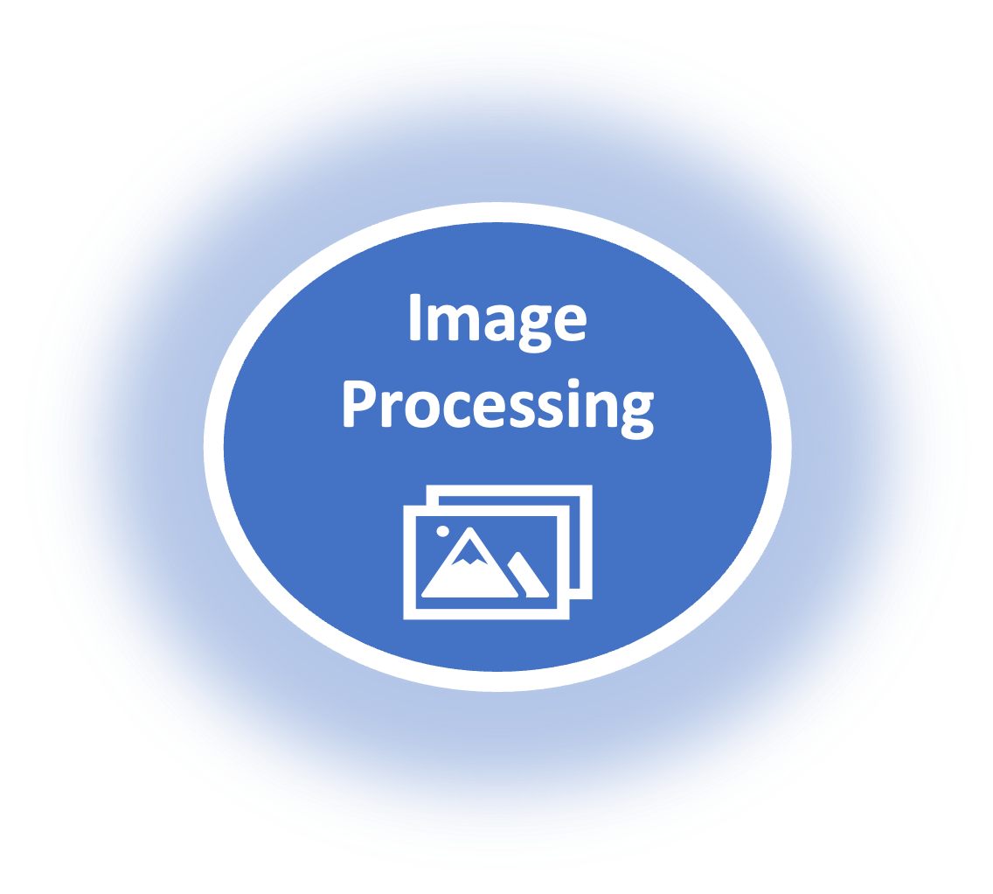
AI
Document Processing
Marketing
Sentiment Analysis
Engage Customers
Real-time Analytics
Interactive Chatbots
NLP
Solutions
Predictive Forecasting
Opportunity Scoring & Insights
Lead Scoring & Insights

Slide 2



Einstein Next Best Action (ENBA) is an out-of-the-box Salesforce Platform feature that provides the possibility to configure business rules and filters that surface the best course of action for any user. This tool can offer an array of recommended actions immediately accessible from within Salesforce.
Display Right Recommendation at the Right Time to the Right Users in salesforce. It enables you to display right recommendations and actions to your agents at right time. It can also used in communities to display recommendation to your customers, you can integrate data from salesforce and non-salesforce sources to get better insights and recommendations. Develop a strategy that applies your business logic to refine those recommendations. Your strategy distills your recommendations into a few key suggestions, like a repair, a discount, or an add-on service. Display the final recommendations in your Lightning app or Experience Builder site.
The goal of ENBA is to display the best action to the right user at the right time — supercharging employees, partners, and customers.
NEXT BEST ACTION
Recommend the next best possible action

Slide 3
To recommend the next possible action to the user, based on certain strategies, certain criteria or certain business rules, that business provides to us.
You want to prompt users to take specific actions based on certain conditions. for ex:- If a customer doesn’t have service contract, NBA prompts agents to sell service contracts or if customer’s payment is overdue, NBA can prompt account executives to follow up.
Concept behind Next Best Action

Slide 4
FLOWS
RECOMMENDATIONS
NBA Considerations
STRATEGIES

Slide 5
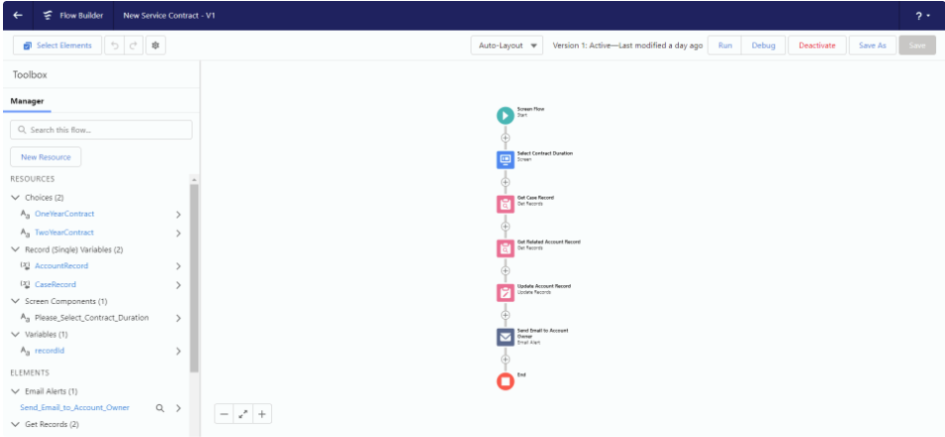
FLOWS
Example :-
First, you’ll need to create a Screen Flow. This could be something like an “Upsell Offer” or “Send a Technician” flow for a Service Agent, or a “Project Feedback” flow. Think of these flows like “offers” — these are things that you might want your users to do, but not all the time, and they should only show up based on sets of criteria that you’ll define later.
we must need to have a flow, that is required by all recommendations. If you don’t have flow, recommendations can’t be created. we can make recommendations using an inactive flow, but only recommendations having an active flow can be listed using strategies.

Slide 6
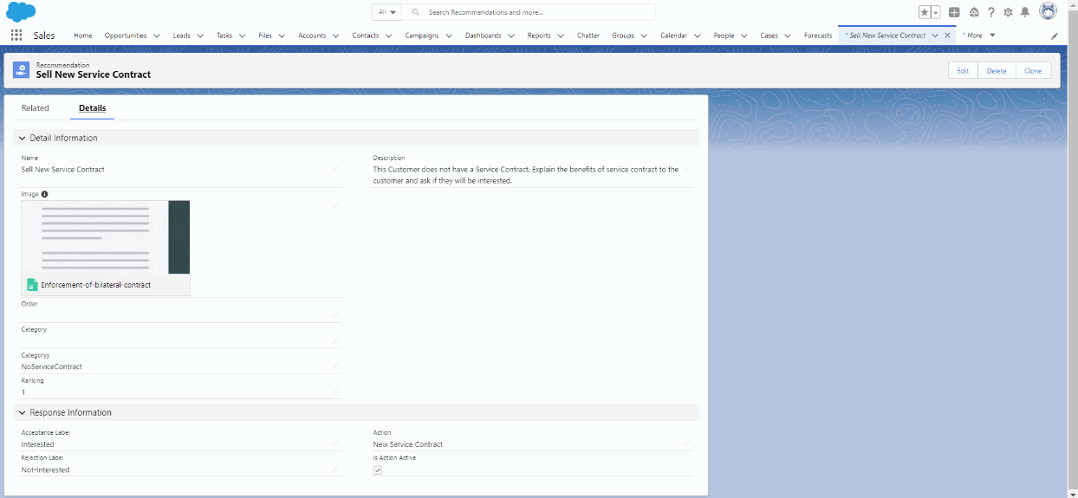
RECOMMENDATIONS
Example :-
Once you’ve created your flow, you’ll need to create at least one Recommendation. Think of a Recommendation like a small banner ad for a specific flow that will appear on the screen based on the logic you will create later. You’ll want these to appear to a support agent using Salesforce to advise them at the right time to upsell a customer or send a technician out to fix some equipment. You could also use them for a Community user who may want to find out more about a new product. These recommendations are ways you get people launched into a specific flow at the right time in your business process.
The best way to create a new Recommendation is to go to the Recommendations tab right from the App Launcher (if you don’t see it, make sure it is not hidden for your current profile). You can have a name, an image, and some custom labels for your users to either accept or reject the recommendation that shows up on the screen. You’ll also tie that recommendation back to the specific flow that you built earlier. Each recommendation can be tied to exactly one flow. You can create multiple recommendations, one for each flow you might want to appear. If you anticipate building a lot of Recommendations, you might want to add custom “category” and “ranking” fields to the Recommendation object, just like you would add any custom field, to help with sorting and ordering your recommendations.

Slide 7
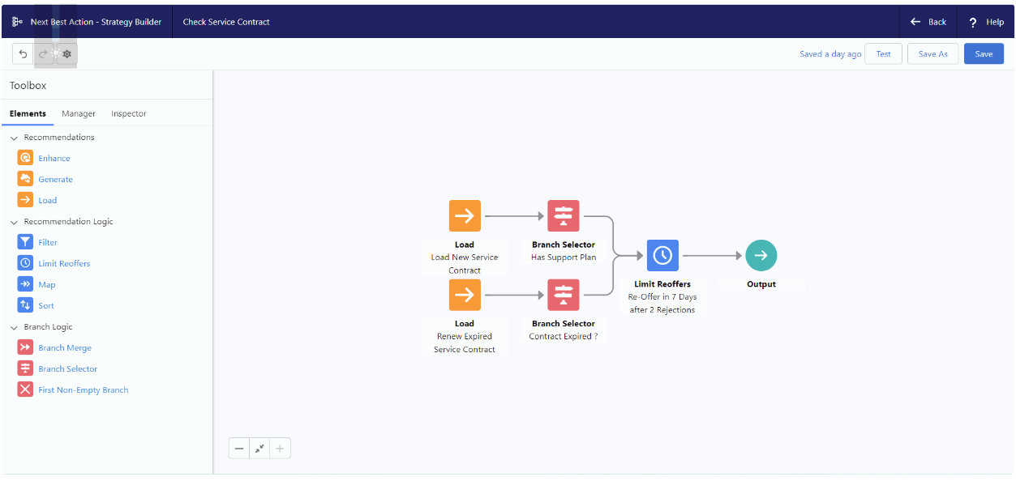
STRATEGIES
Now that you have your flow(s) and recommendation(s), you’ll need to decide when and where they will appear. This is where the real power of Einstein Next Best Action comes – your strategy allows you to surface those recommendations you created and tied to individual flows to the right users at the right time, based on exactly what your business requirements are. For a tech support agent, this might be a recommendation to send a technician out but only for certain sized customers in a specific geographical region, and we may only want it to appear once every 90 days. Your strategy model can be as simple or complex as you need, it’s completely up to you.
The most important thing to do in your Strategy is to select which object the strategy will apply to. You’ll use the “Strategy Builder” tool in Setup to create your strategies. This tool looks very similar to Flow Builder, with some slightly different components.
Once you’ve selected your object, like “Case”, then you’ll need to Load your Recommendations by adding a Load element. Use Filter to weed out recommendations that don’t make sense, and use Branch Select to shut down branches that don’t make sense.

